Slide 1

Rossman Pharmaceutical sales prediction across multiple stores
SUBMITTED BY : HARI HARAN M

Slide 2
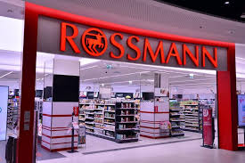
INTRODUCTION
Predicting sales performance is one of the key challenges every business face.
It is important for firms to predict customer demands to offer the right product at the right time and at the right place.
The importance of this issue is underlined by the fact that figuratively a bazillion consulting firms are on the market trying to offer sales forecasting services to businesses of all sizes.

Slide 3
Project Need
Currently, Rossmann store managers are tasked with predicting their daily sales for up to six weeks in advance.
Store sales are influenced by many factors, including promotions, competition, school and state holidays, seasonality, and locality.
With thousands of individual managers predicting sales based on their unique circumstances, the accuracy of results can be quite varied.
Rossmann operates over 3,000 drug stores in 7 European countries

Slide 4
Datasets and features
Id - an Id that represents a (Store, Date) duple within the test set
Store - a unique Id for each store
Sales - the turnover for any given day (this is what you are predicting)
Customers - the number of customers on a given day
Open - an indicator for whether the store was open: 0 = closed, 1 = open
StateHoliday - indicates a state holiday. Normally all stores, with few exceptions, are closed on state holidays. Note that all schools are closed on public holidays and weekends. a = public holiday, b = Easter holiday, c = Christmas, 0 = None
SchoolHoliday - indicates if the (Store, Date) was affected by the closure of public schools
StoreType - differentiates between 4 different store models: a, b, c, d
Assortment - describes an assortment level: a = basic, b = extra, c = extended.

Slide 5
Datasets and features
CompetitionDistance - distance in meters to the nearest competitor store
CompetitionOpenSince[Month/Year] - gives the approximate year and month of the time the nearest competitor was opened
Promo - indicates whether a store is running a promo on that day
Promo2 - Promo2 is a continuing and consecutive promotion for some stores: 0 = store is not participating, 1 = store is participating
Promo2Since[Year/Week] - describes the year and calendar week when the store started participating in Promo2
PromoInterval - describes the consecutive intervals Promo2 is started, naming the months the promotion is started anew. E.g. "Feb,May,Aug,Nov" means each round starts in February, May, August, November of any given year for that store

Slide 6
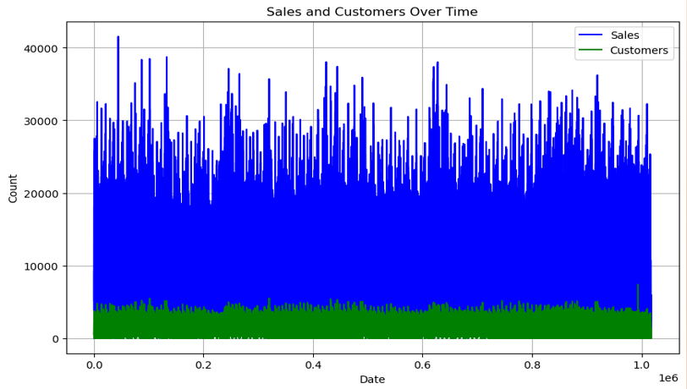
The sales is directly related to customer

Slide 7
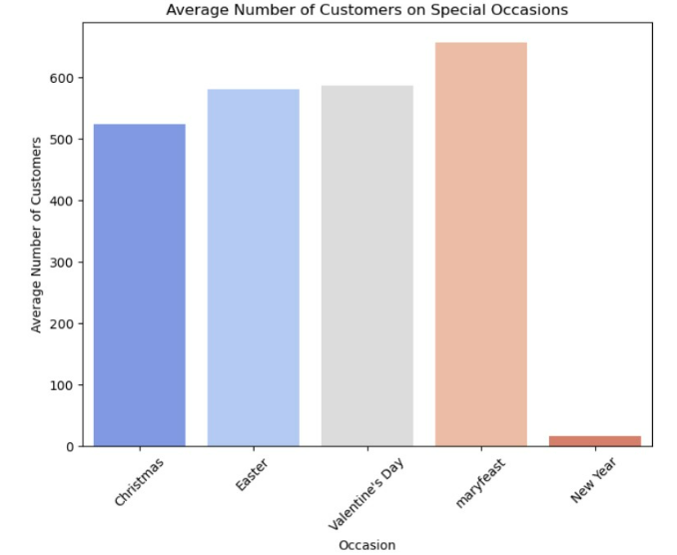
In this presentation, we delve into the intriguing correlation between Halloween, the beginning of winter, and its impact on pharmaceutical store sales. Halloween drives consumer behavior, leading to increased spending and social gatherings .
As Marryfest arrives, it signals the onset of the winter season with colder weather and climatic changes .
This transition has notable health implications, making individuals more susceptible to illnesses like colds, flu, and seasonal affective disorder.
Consequently, pharmaceutical store sales surge, as consumers seek health-related products.
To capitalize on this surge, pharmaceutical stores can employ seasonal marketing strategies while also addressing specific health needs during winter.
In conclusion, recognizing and catering to this seasonal sales phenomenon is key for pharmaceutical stores.

Slide 8
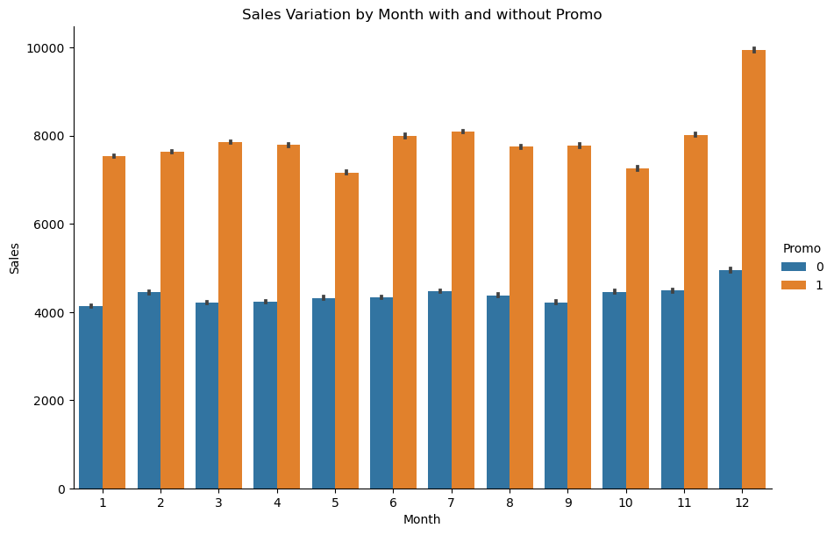
Promotions play a pivotal role in driving sales in pharmaceutical stores, with December emerging as a strategic hotspot for these marketing endeavors.
Notably, the period from December 22nd to 25th, encompassing the Christmas holiday, witnesses a surge in promotional activities.
This timing aligns with the transition from winter to spring, a critical juncture when consumers seek health-related products.

Slide 9
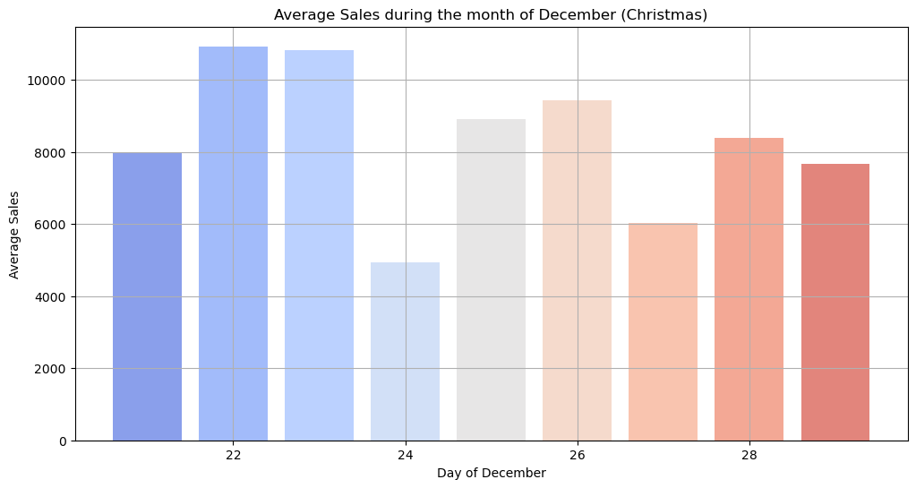
Pharmacies strategically capitalize on this consumer behavior by offering discounts, special deals, and targeted promotions during this festive season.
Recognizing the correlation between seasonal transitions, heightened health concerns, and promotions is crucial for pharmaceutical stores to maximize their sales potential.

Slide 10
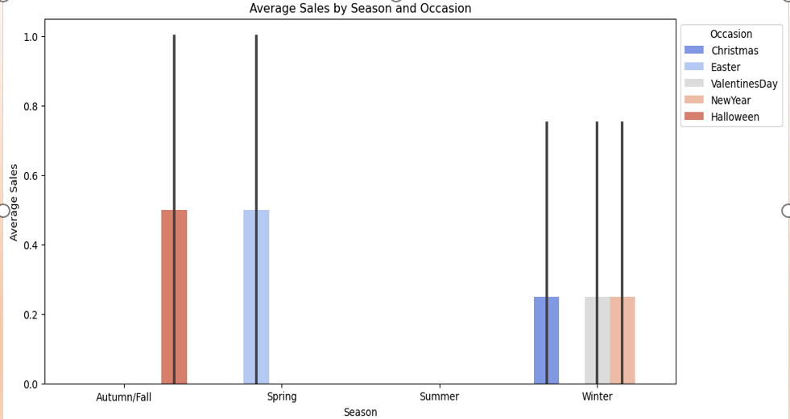

Slide 11
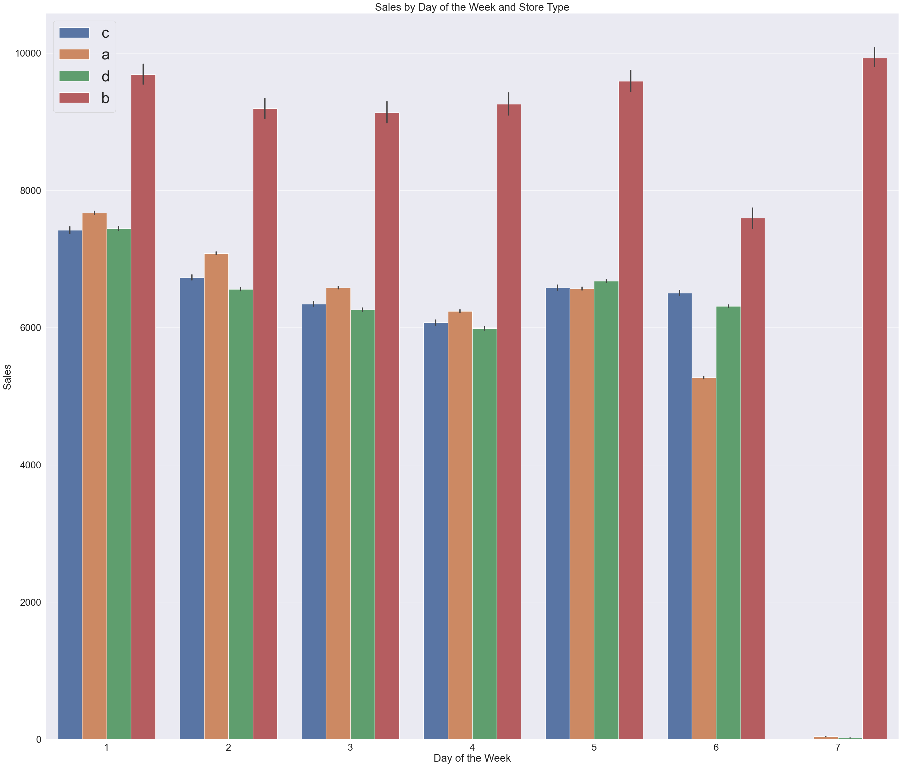
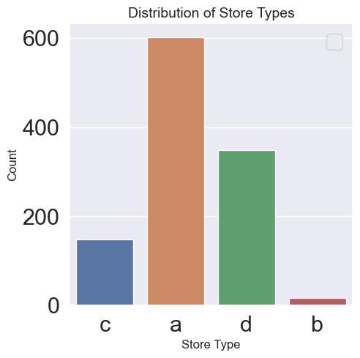
There are four store types: A, B, C, and D.
Store A has more locations, but store B has higher weekly sales.

Slide 12
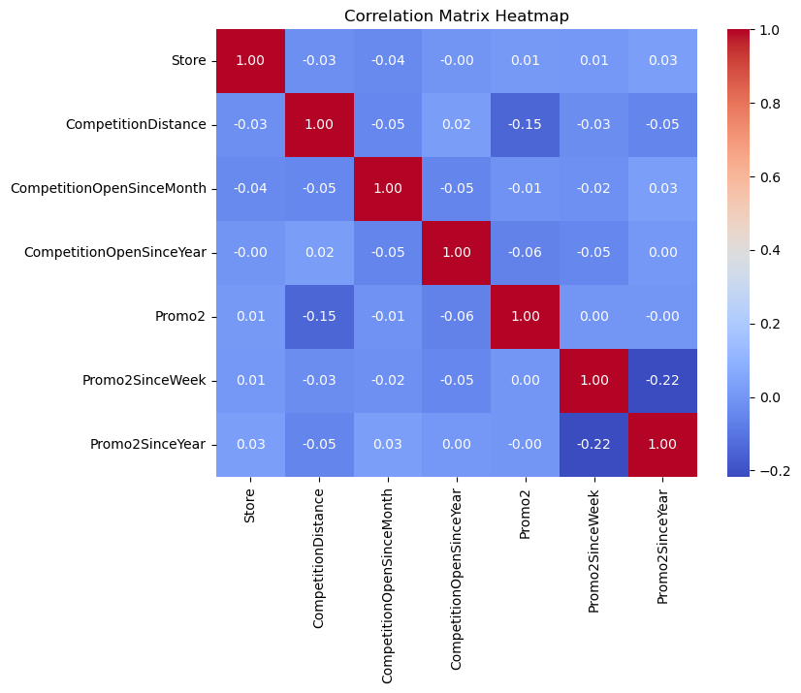

Slide 13
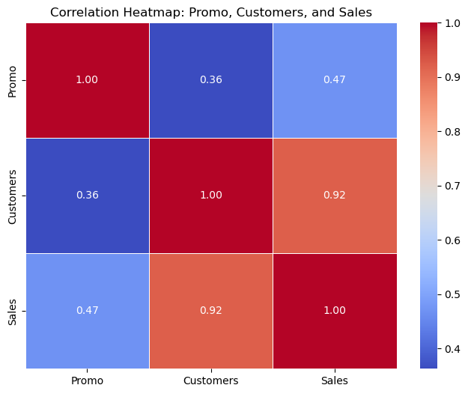
There is a very strong correlation between sales and customers; an increase in customers leads to an increase in sales accurately describes a fundamental principle of business.
It highlights the positive relationship between the number of customers a business serves and its overall sales.

Slide 14
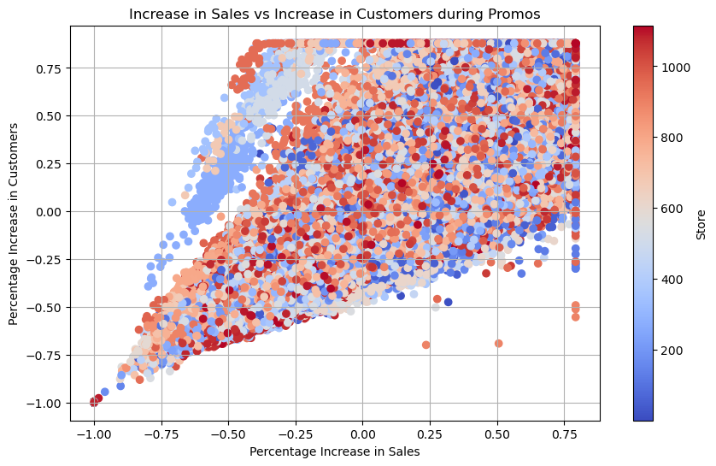
When more customers visit or engage with a business, it often results in higher sales revenue.
This concept underscores the importance of attracting and retaining customers as a key driver of business growth and success.

Slide 15
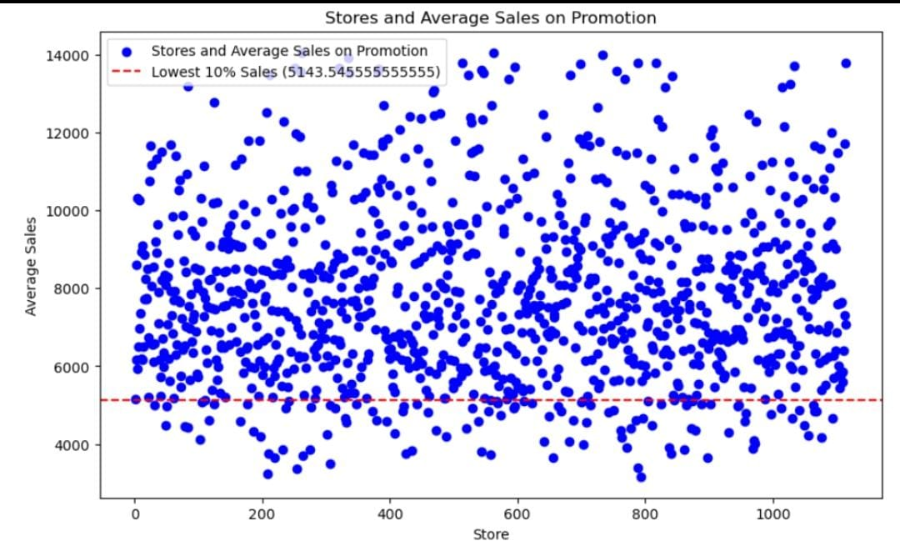
Average sales promotion we have 112 stores which will need more promotion to increase the sales

Slide 16
Conclusion of EDA
The most selling and crowded StoreType is A.
The best "Sale per Customer" StoreType D indicates to the higher Buyer Cart. To benefit from this fact, Rossmann can consider proposing bigger variety of its products.
Low SalePerCustomer amount for StoreType B indicates to the possible fact that people shop there essentially for "small" things. Even though this StoreType generated the least amount of sales and customers over the whole period, it shows a great potential.
Customers tends to buy more on Mondays when there's one promotion (Promo) and on Sundays when there's no promotion at all (both Promo and Promo1 are equal to 0).
Promo2 alone doesn't seem to be correlated to any significant change in the Sales amount.

Slide 17
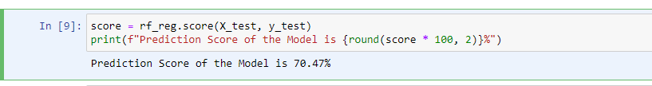
Prediction of store sales
For PreProcessing here using LabelEncoder, MinMaxScaler, and RandomForestRegressor model.
Prediction score of the model is 70.47%

Slide 18
Building models with sklearn pipelines
Prediction Score of the RandomForestRegretion is 63.47%
Prediction Score of the LinearRegretion is 57.65%
Prediction Score of the DecisionTree is 50.02%
Choose a loss function
RandomForest Root Mean Square Error: 2058.9773134579336
Linear Root Mean Square Error: 2217.142471012501
DecisionTree Root Mean Square Error: 2408.6399513003184

Slide 19
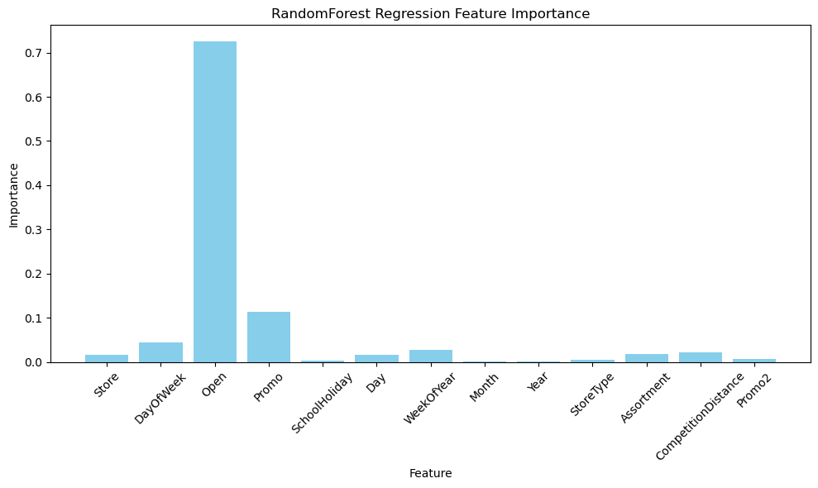
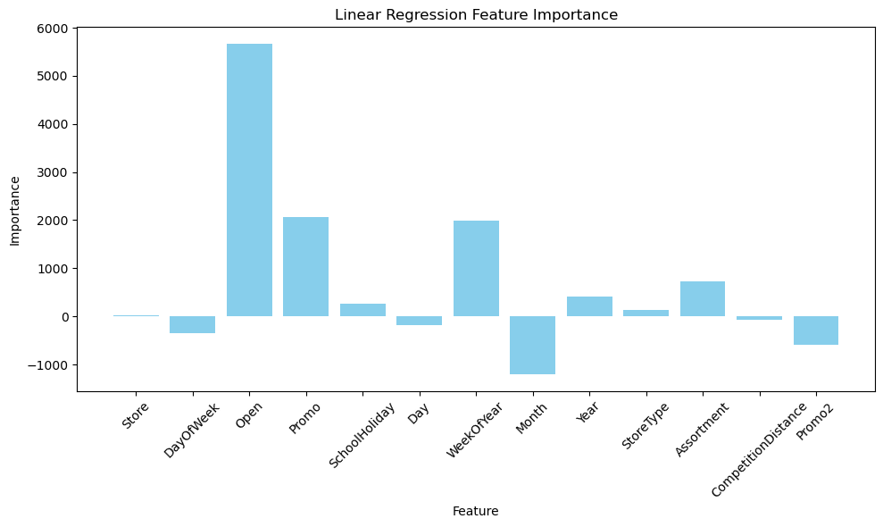
Post Prediction Analysis : Feature Importance

Slide 20
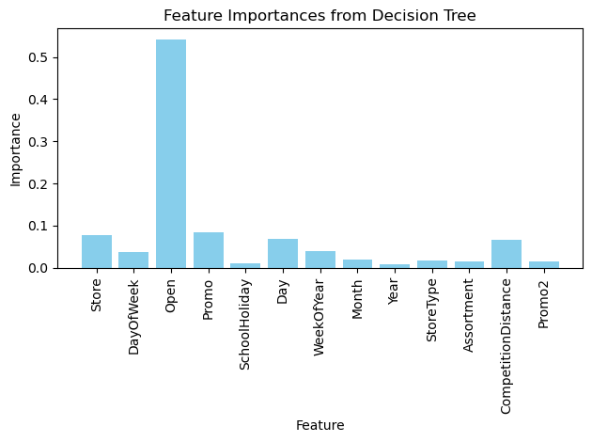

Slide 21



Serialize models
Read and save model -- serialization using pickle to dump mode
Regression Score:
Decision Tree Score:
Linear Regression Score:

Slide 22
Time Series Analysis
Time-Series Analysis per Store Type
We build a time series analysis on store types instead of individual stores. The main advantage of this approach is its simplicity of presentation and overall account for different trends and senasonalities in the dataset.
Seasonality and Yearly Trend
We take four stores from store types to represent their group:
Store number 2 for StoreType A
Store number 85 for StoreType B
Store number 1 for StoreType C
Store number 13 for StoreType D.
We take four stores from store types to represent their group: Store number 2 for StoreType A Store number 85 for StoreType B, Store number 1 for StoreType C Store number 13 for StoreType D. It also makes sense to down sample the data from days to weeks using the resample method to see the present trends more clearly.

Slide 23
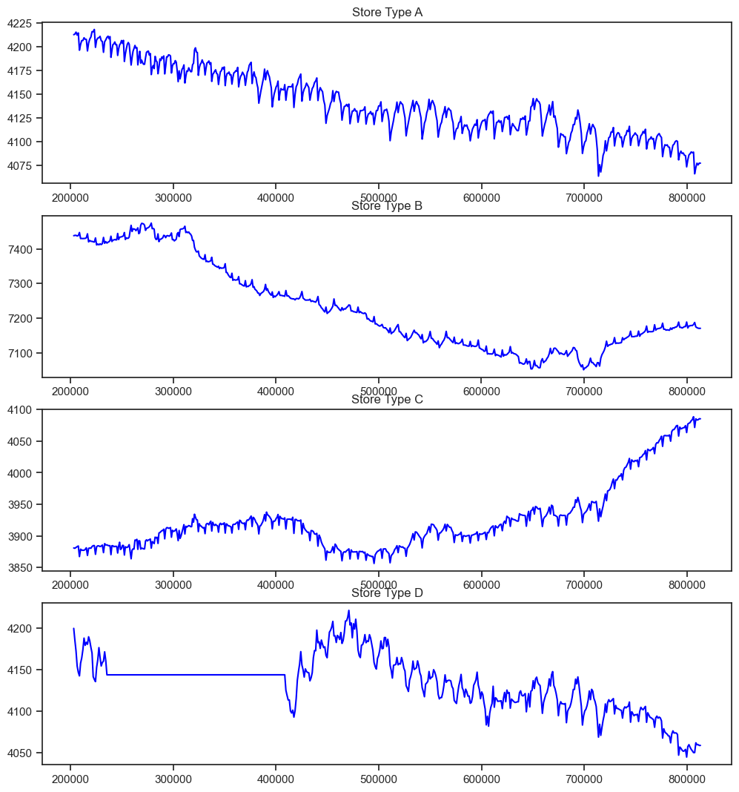
Observation: Overall sales seems to increase, however not for the StoreType C (a third from the top). Eventhough the StoreType A is the most selling store type in the dataset, it seems that it can follow the same decresing trajectory as StoreType C did.

Slide 24
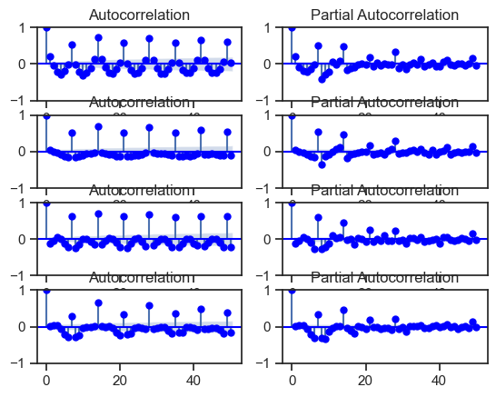
We can read these plots horizontally. Each horizontal pair is for one 'StoreType', from A to D. In general, those plots are showing the correlation of the series with itself, lagged by x time units correlation of the series with itself, lagged by x time units.

Slide 25
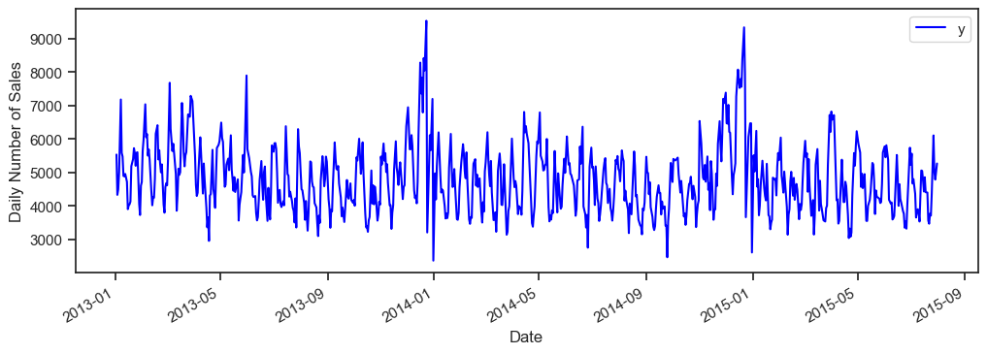

Slide 26
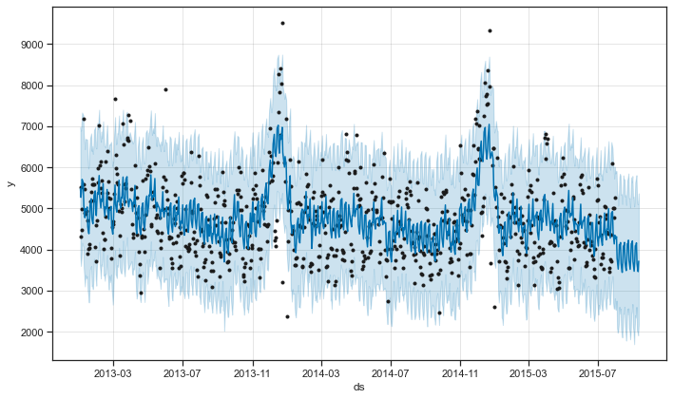
Modeling Holidays: Prophet also allows to model for holidays, and that's what we do here.
The StateHoliday variable in the dataset indicates a state holiday, at which all stores are normally closed. There are also school holidays in the dataset at which certain stores are also closing their doors.
Observation: Prophet plots the observed values of our time series (the black dots), the forecasted values (blue line) and the uncertainty intervals of our forecasts (the blue shaded regions).

Slide 27
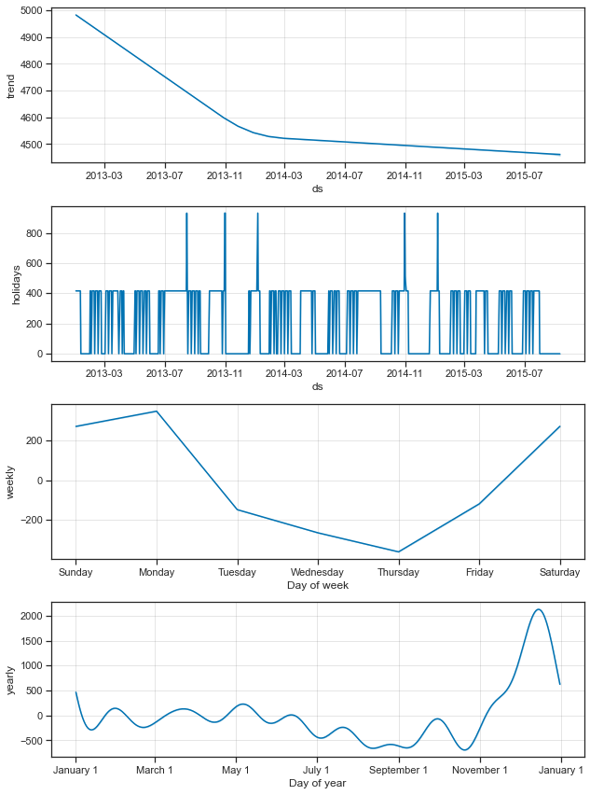
One other particularly strong feature of Prophet is its ability to return the components of our forecasts. This can help reveal how daily, weekly and yearly patterns of the time series plus manually included holidays contribute to the overall forecasted values:
Observation:
The first plot shows that the monthly sales of store number 1 has been linearly decreasing over time.
The second shows the holidays gaps included in the model.
The third plot highlights the fact that the weekly volume of last week sales peaks towards the Monday of the next week.
while the forth plot shows that the most buzy season occurs during the Christmas holidays.

Slide 28
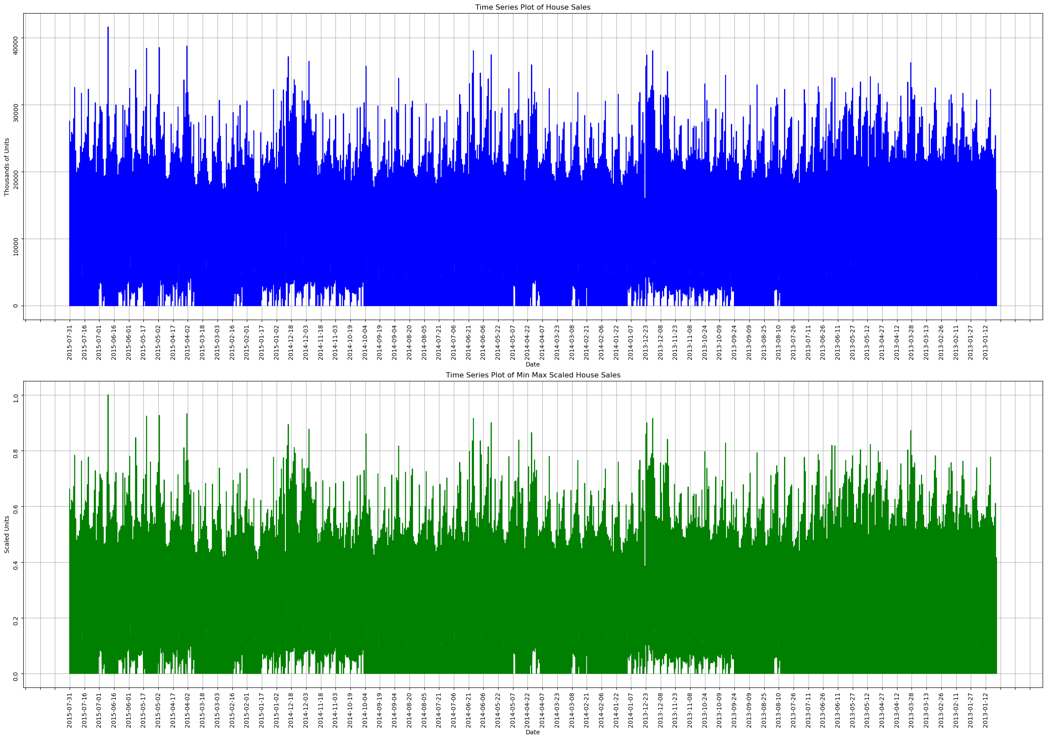

Slide 29
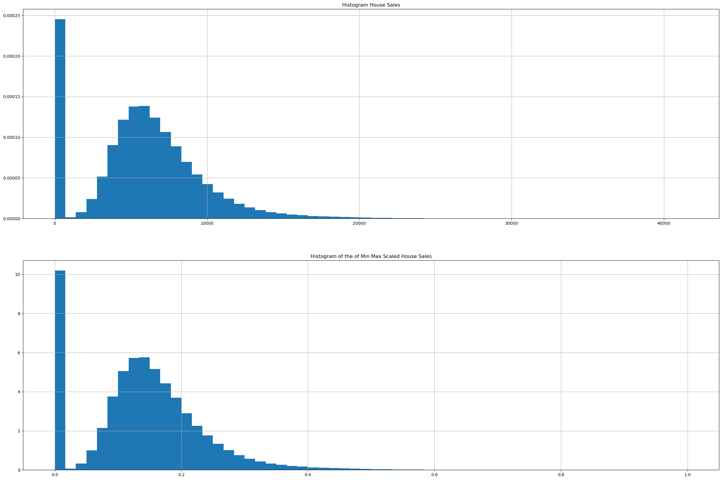

Slide 30
Deep Learning
Check whether your time Series Data is Stationary or non-stationary
KPSS Statistic: 0.7011624739400044
p-value: 0.013439775096363234
Number of lags used: 553
Critical Values: 10%: 0.347
5%: 0.463
2.5%: 0.574
1%: 0.739
KPSS test result: Non-stationary (reject null hypothesis)

Slide 31
THANK YOU
Guided By : Desmond Onam Sir
Shweta Sutar Mam

